Slide 1
Formal Language Recognition with the Java Type Checker
ECOOP 2016
20th July 2016
Yossi Gil and T. Levy
Fluent API
Notes:
Thank you for the presentation.
This is joint work with Tomer Levy
In this talk, I will try to explain how formal language theory comes essential to fluent APIs.

Slide 2
Formal Languages?
Terms: Finite/Stack automata, Turing machines, Context Free Languages, BNF, Deterministic languages, …
Tools: polynomial and exponential reductions, pumping lemma, …
Applications:
  Complexity!
  Computability!
  OOP? Software engineering?
This work: applying formal language theory for implementing fluent API’s in Java
Notes:
Let me remind you what we speak about when we say “formal languages”

Slide 3
Fluent API
// What’s T in “Yossi Gil and T. Levy”? new Query() .select(First).from(Employees) .where(lastName.eq(“Levy”));
// What’s T in “Yossi Gil and T. Levy”? new Query() .select(First).from(Employees) .where(lastName.eq(“Levy”));
Java:
  jOOQ – a platform for type-safe sql queries
  Hamcrest – a fluent testing framework in Java
  LINQ – a Microsoft .NET framework for queries
  jRTF – a Java library for building RTF documents
  jOOR, EasyMock, Apache Camel, …
C++: (compiler is Turing complete (Gutterman))
  Symbolic expressions+symbolic derivation (Gil and Gutterman)
  Expression templates
  AraRat: SQL with C++ operators (Gil and Lenz)
Notes:
This is a fluent API example. In the example, we construct a query with might be called method chaining.
We first create a Query object, then we modify it, by sending it a select method, and then a where a method.
This is kind of method chaining, but as we shall see it is more than method chaining.

Slide 4
Fluent API is neat
(more so with Java 8)
eval( // Conditionals with fluent API () -> { list.add(this); } ).unless(list.contains(this));
repeat( // Worklist algorithm with fluent itertation () -> { Task todo = work.pop() Set<Task> fresh = process(todo); work.push(ts); } ).until(work.empty());
Notes:
Fluent API can be neat.
In the examples, I use my own fluent API library to code. In fact, I can embed structured programming within my fluent API.
Eval and unless are fluent API methods.
The first call stores some statements. The second call evaluates unless someconditio is met.
We have here a conditional.We add something to a list, unless the list already contains this value.
In the second example, I use a fluent API looping construct to emulate a worklist algorithm.
Repeat and until are my methods.
In the example, I use these to do the iterative worklist algorithm.

Slide 5
Fluent API is neat (cont.)
try { eval( // sequential execution () -> { DB.lock(); } ).then( () -> { DB.commit(this); } ).then( () -> { DB.unlock(); } }; } catch (…) { … }
Notes:
This is the third example of my own fluent API.
We say conditionals, we saw loops. All that remains to do structured programing, is sequential execution.
In this example, Again, we have two methods: then and eval.
The second then is evaluated only when the first succeeds.
So we emualted sequential programmin

Slide 6
Why Fluent API
Neat
Your own DSL!
Frameworks: smooth the learning curve
Type states and object protocols:
  Very common
Notes:
Fluent API is neat, it is also a very portable way to implement your own DSL.
Moreover, with fluent API’s it should be easy to program certain complex frameworks.
And, we will see that fluent API is good for coding type states and object protocols.

Slide 7
Fluent API is also Safe
Lets say we want an SQL query
SELECT * FROM BOOKS
WHERE BOOKS.PUBLISHED_IN = 2011
ORDER BY BOOKS.TITLE

Slide 8
SQL the Old Way
Lets say we want an SQL query
We can use the (old) JDBC
SELECT * FROM BOOKS
WHERE BOOKS.PUBLISHED_IN = 2011
ORDER BY BOOKS.TITLE
Language
dependent
String query =
“SELECT * FROM BOOKS WHERE PUBLISHED_IN = 2011
ORDER BY TITLE”;
stmt.executeQuery(query);
Typos vulnerability
Security
issues

Slide 9
Fluent API for SQL?
Lets say we want an SQL query
We Would like ...
SELECT * FROM BOOKS
WHERE BOOKS.PUBLISHED_IN = 2011
ORDER BY BOOKS.TITLE
But how?
Language
independent
query().selectFrom(BOOK)
.where(BOOK.PUBLISHED_IN.eq(2011))
.orderBy(BOOK.TITLE)
Typos
won't compile
Easier to enforce
security

Slide 10
Incorrect Fluent API for SQL
A concept known
as method chaining
Naive implementation
Problem?
  Doesn't enforce correct use of API
class SelectQuery {
static SelectQuery query();
SelectQuery selectFrom(Table t) { … return this; }
SelectQuery where(Predicate<Entry> p) { … return this; }
SelectQuery orderBy(Column c) { … return this; }
}
query().where(..).where(..).orderBy(..).selectFrom(..)
type-checks

Slide 11
Correct Fluent API
So what do we want?
  correct sequences compile
  Invalid sequences do not compile
After each method invocation, we need to know exactly which methods are allowed next
  Highly resembles problems from theory of automata
  We want these automata to be “embedded in the compiler”

Slide 12
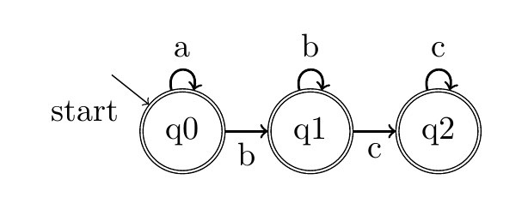
Automata Theory
  Recognition of languages
  Does word w is in some language L ?
What does this do?
a*b*c*
Notes:
This is where formal languages theory comes into play

Slide 13
Let's do this!
Conclusion:
We “embedded” the automaton
in the compiler
class q0{
q0 a();
q1 b();
}
class q1{
q1 b();
q2 c();
}
class q2{
q2 c();
}
new q0().a().a().b().b().c();
new q0().a().a().b().b().c().a();
Compilation error!
type q2 has
no method a()
Returned type is q2
Returned type is q0
Returned type is q0
Returned type is q2
Returned type is q0
Returned type is q1
Returned type is q1

Slide 14
So are we done?
No!
DFAs define a rather small set of languages
  Called regular languages
In order to increase expressiveness, we need a stack
  We'll emulate it using the Java Generics mechanism
  Enables us to “define” infinite number of types

Slide 15
Reduction to Automata Theory
Alphabet = Method invocations
Words = method sequences
Language = API allowed sequences
How can we define languages?
{ query(), where(Predicate<Entry>), orderBy(Column), selectFrom(Table) ... }
{query().where(..).query() , orderBy(..).selectFrom(..) … }
{ query().selectFrom(..) ,
query().selectFrom(..).where(..) ,
query().selectFrom(..).orderBy(..) ,
query().selectFrom(..).where(..).orderBy(..) … }

Slide 16
Language Definition by BNF
BNF is a common language definition tool
Examples :
  Numbers
  Balanced stack operations
<digit> ::= 0 | 1 | 2 | 3 | 4 | 5 | 6 | 7 | 8 | 9
<number> ::= <digit> | <digit> <number>
<Balanced> ::= push <Balanced> pop <Balanced> | ε

Slide 17
Simple example :
Balanced stack operations
Rest of the stack
Is also a stack
interface Stack<Tail extends Stack<?>> { }
A stack with one
more element
Rest of the stack
interface One<Tail extends Stack<?>>
extends Stack<Tail>{
One<One<Tail>> push();
Tail pop();
}
interface Empty extends Stack<Empty> {
One<Empty> push();
}

Slide 18


Example : balanced stack operations
interface Stack<Tail extends Stack<?>> { }
interface One<Tail extends Stack<?>>
extends Stack<Tail>{
One<One<Tail>> push();
Tail pop();
}
interface Empty extends Stack<Empty> {
One<Empty> push();
}
test(){
Empty e = (Empty)null;
One<Empty> p1 = e.push();
One<One<Empty>> p2 = p1.push()
e.push().push().pop().pop();
e.push().push().pop().pop().pop();
}
Type checks
compilation error
at last pop()
Empty has no member pop()

Slide 19
Toolbox of Java Generic Programming
Technique I: Type state- encoding of functions and partial functions
Technique II: Prolog Like Unification (non recursive)
class q0{
q0 a();
q1 b();
}
class q1{
q1 b();
q2 c();
}
class q2{
q2 c();
}

Slide 20
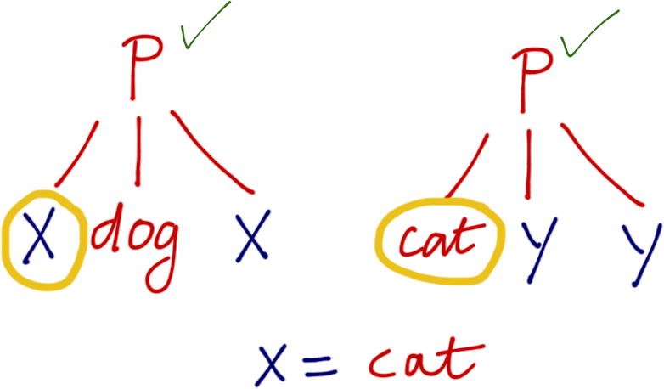
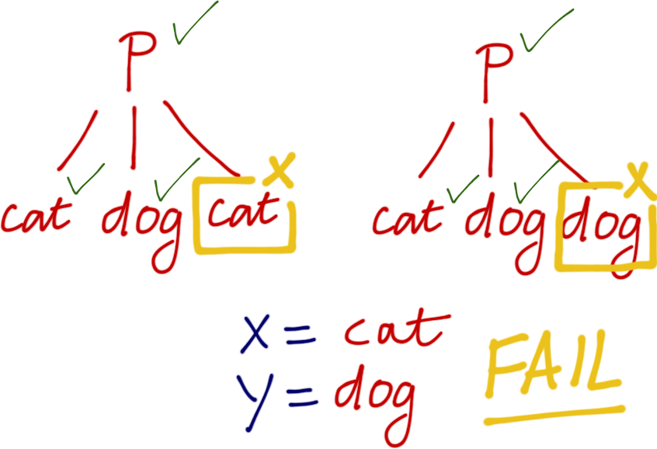
Unification
Technique II: Unification can be emulated with the Java generics type system

Slide 21
Technique III: The Jump Stack
Operations on a jump stack
  Push
  Pop
  JumpX(), JumpY(), … – pop everything until x, y
Implementation:
  O(1) time with pointers
  Crucial result: O(1) time with Java generics.
JumpX
y
y
x
x
y
x
x
y
Push
Pop
JumpY
y

Slide 22
Finally
Main result: any “reasonable” BNF language can be converted into fluent API.
  Reasonable = LL / LR / “deterministic” language
  Cost = Exponential blowup
Continuing Work: Fajita, a fluent API generator, using LL
Main question: Is the Java compiler guaranteed to terminate? Turing Complete

